Slide 1

THIS PROJECt BASED ON SQL
ASSIGNMENT=1&2
PRESENT BY :
RAHULKUMAR
VISHWAKARMA

Slide 2
SQL CLASSIFICATION
DDL
DCL
TCL
DML

Slide 3

WORKING ON DATA BASE
CREAT DATABASE
DROP DATABASE
MANAGE DATA BASE

Slide 4
DATA TYPES
Numeric
Date and time
Character strings
Unicode strings
Binary

Slide 5
Examples is next page

Slide 6
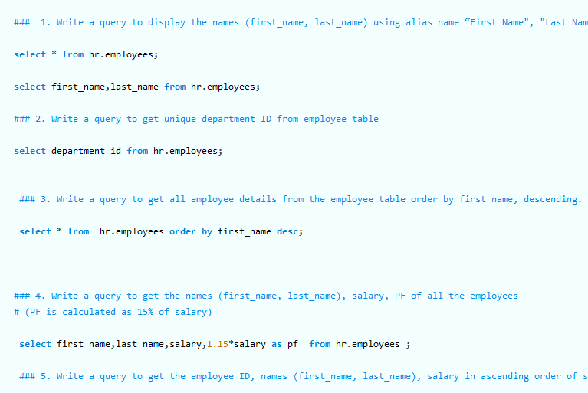
This assignment regarding some Q&A

Slide 7
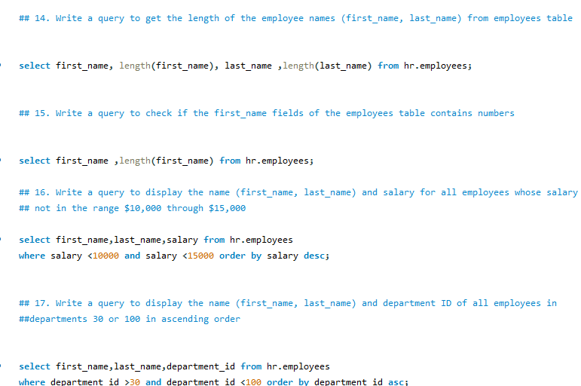

Slide 8
Thank you for watching

